Slide 1
De-risking 3rd Party Access
Overview & Use Case

Slide 2
Overview of Risk

Slide 3
Impact of 3rd Party Supply Chain Risk
High profile organizations have been targeted through supplier and 3rd party access
Jaguar-Land Rover (2025) – Compromised credentials allowed access to an internal JIRA Server which was exploited and PII leaked
Huge reputational damage and an estimated cost of £2B to the UK economy
Truist Bank Data Breach (2024) - 3rd Party debt collection agency was breached and that agency had access to sensitive Truist Bank data
Sensitive PII data leaked for nearly 4.2 million including bank customers
Lawsuits, reputational damage, estimated $400-600M in damages
Marks and Spencers (2025) – Compromised credentials from a contractor IT provider
Online store down for nearly 2 months causing losses of up to £300M, market valuation dropped by £1B

Slide 4
Cause of risk - Legacy 3rd Party Access
Legacy VPN
Designed for connectivity, not security
Overly permissive and designed for implicit trust
No segmentation
No visibility
Enables lateral movement of threats
Use of on-premise appliances
Requires maintenance and management
Extra appliances needed if security is required
Increases time and cost
No consistent security
Scalability challenges
Compromised Credentials

Slide 5
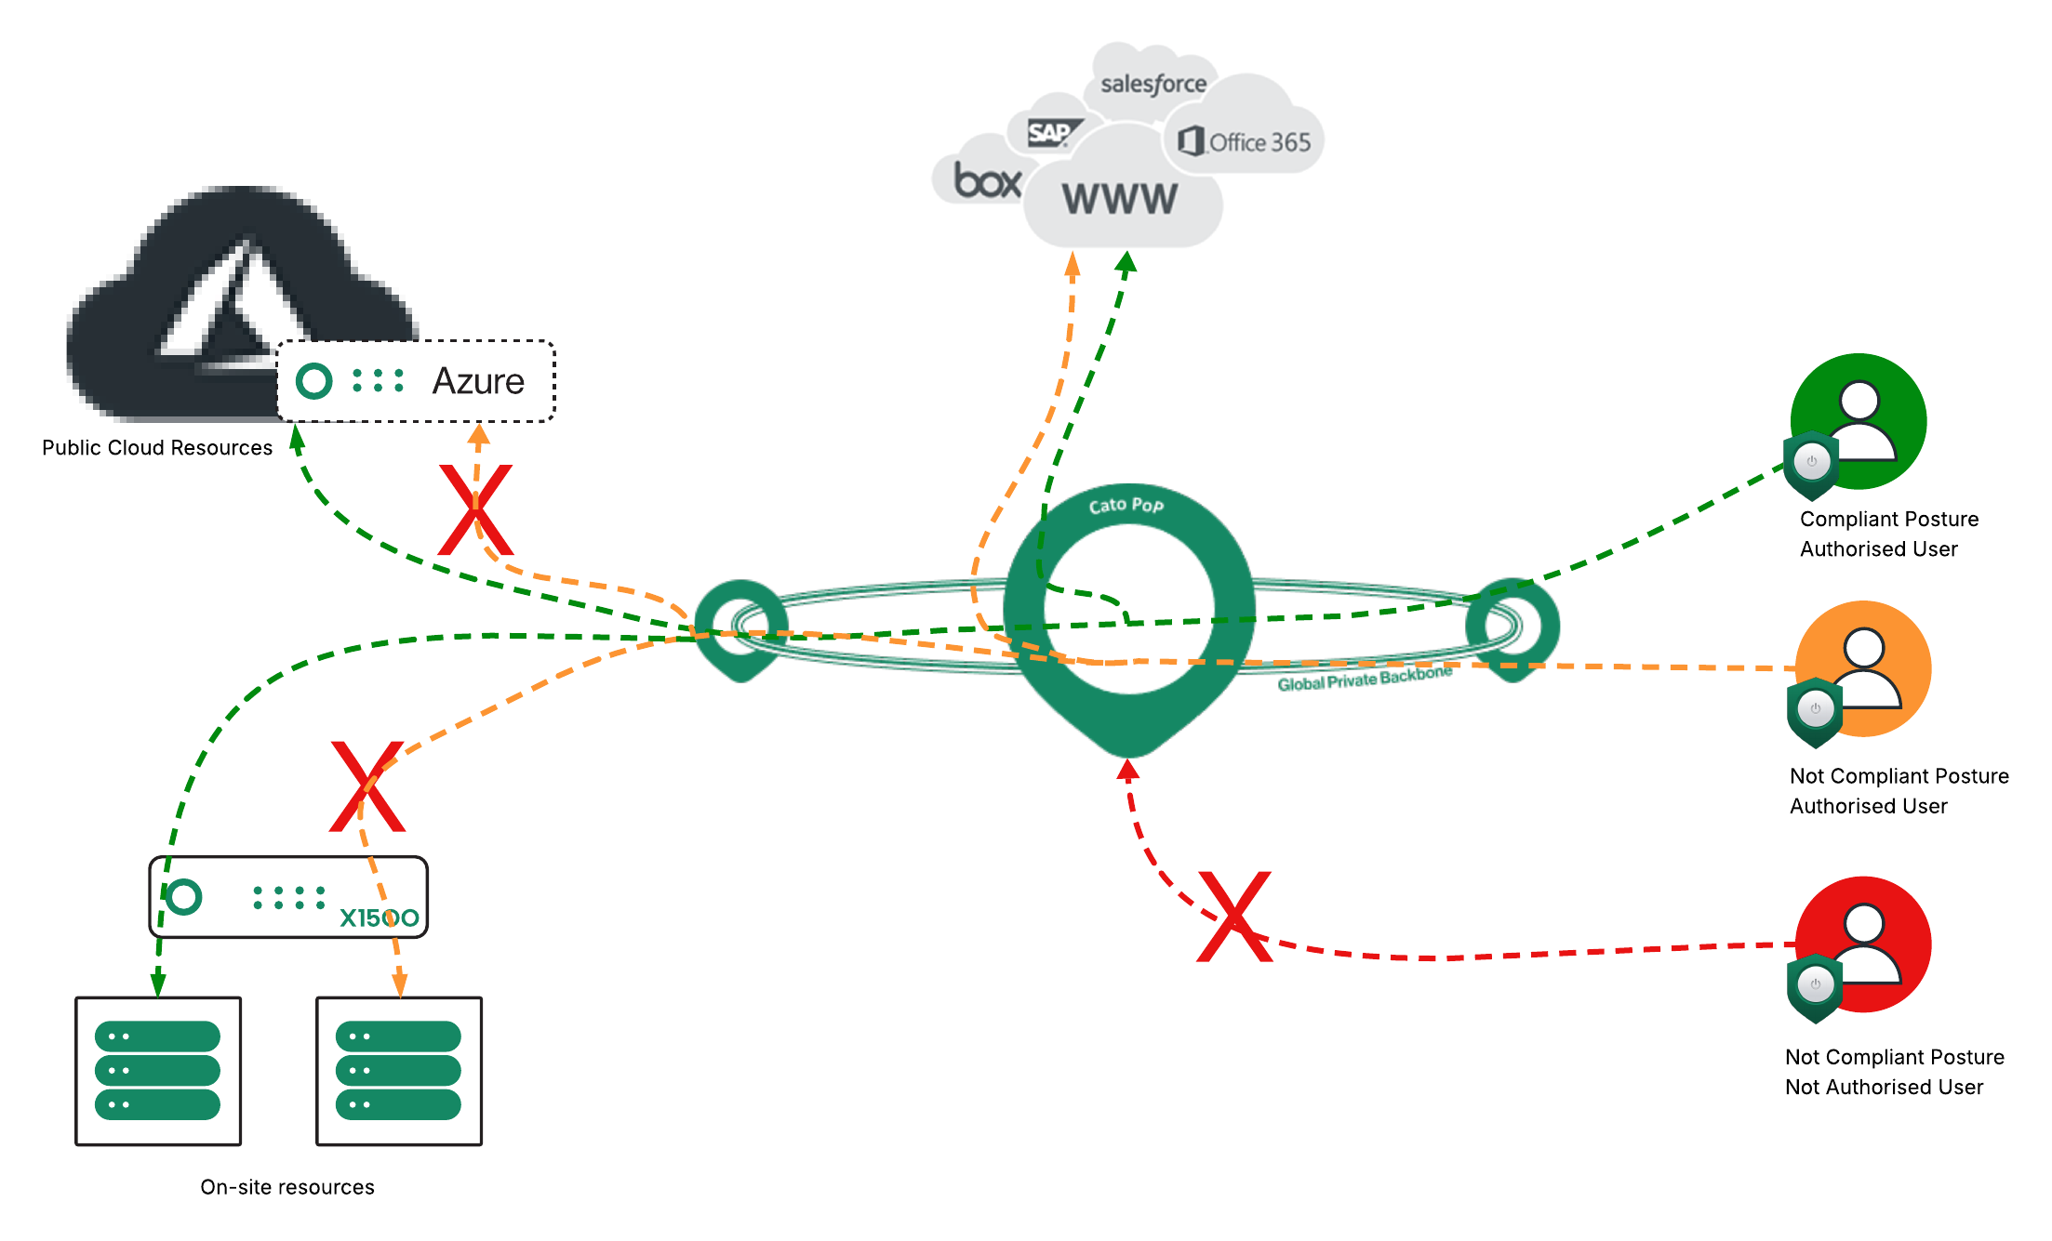
How Cato Networks removes risk from 3rd Party Contractors
Removing risk through least privileged access
Consistent Policy for Users Everywhere
Identity driven
Global coverage
ZTNA: Trust but Verify
Access control with device posture
Threat prevention (FWaaS, SWG, IPS, AM)
Sensitive data protection (DLP)
Risk-based applications access control (CASB)
Notes:
[click1]
Enterprises today need to connect the hybrid workforce, securely, wherever they are. Users seamlessly roam between the office, customer locations, travel, and their homes.
[click2]
Cato SSE 360 enforces a consistent policy on users based on their identity.
The global cloud service seamlessly distributes the relevant policies globally, so policies are enforced consistently across the globe.
And, there is no need to backhaul traffic across the world to a single VPN appliance, or deploy global instances to achieve the same goal.
[click3]
Cato SSE 360 delivers true Zero Trust with continuous verification. Access control, threat prevention, and sensitive data protection are continually enforced on all traffic, throughout the user’s session.
Using Cato for the hybrid workforce was proven During COVID.
Our customers were able to support all their users transitioning to home working, without giving up security - due to the reach and scalability of the Cato solution.

Slide 6
How to run the demo ( SE only slide )
Removing risk through least privileged access
Initial discussion with prospect to dig into the ‘why’ they are looking at security for 3rd parties, contractors etc. Understand business use case for this access and risk surrounding it
First slide – Business impact of not securing 3rd party access
Second slide – How 3rd parties currently access resources, limitations and risk around this
Overview of Cato ZTNA and how we use device posture, confidence, user awareness to enable least privileged access. Security capabilities like FWaaS and SWG, CASB and DLP to protect sensitive data and prevent breaches
Red line – geoblocking, unauthorized users and/or non-compliant devices
Orange line – Internet only, user authenticates but is not compliant
Green line – WAN and Internet – user authenticated and device compliant
Demo
Start off with showing Access Tab > Client connectivity (geoblocking rules, rules for user groups, internet only rules) talk around this as examples on how to restrict that initial connectivity
WAN firewall rules – show rules with contractor user groups only allowed to access certain resources, corporate users must be compliant with device profile.
Show device posture profiles and criteria we can do.
Show live demo of a contractor user being blocked from internal resource but able to access another resource (HTML code for web pages in folder – contractor portal and internal portal)

